Slide 1
EMBEDDED NETWORKS
UNIT - II
USB AND CAN BUS

Slide 2
CONTENTS
1) Introduction to USB
2) USB Bus communication
3) Speed identification on the Bus
4) USB states
5) Descriptors
6) PIC18 Microcontroller Usb Bus Interface
7) Message frames in CAN protocol
8) Bit stuffing
9) Types of errors:
10) Nominal Bit timing:
11) PIC Microcontroller CAN interface

Slide 3
INTRODUCTION TO USB
USB stands for Universal Serial Bus. This is mainly used as an interface in electronic consumer products like PC’s, camera’s, GPS Devices, MP3 players, modems etc.
USB was originally developed by Compaq, Microsoft, Intel, and NEC (Nippon Electric Company Ltd). Later this USB was further developed by Hewlett-Packard, Lucent and Philips.
USB bus is a complex protocol and a high speed serial interface that can also provide power to devices connected to it.

Slide 4
About 127 devices can be supported by the USB bus. These 127 devices are limited by the 7 bit address field where in address 0 is not used which has a special purpose.
These devices are connected through a four wire serial cable of about three or five meters in length.
Hubs will be used in connection of many USB devices connected to same bus which can have 4-16 ports.
USB connections can be extended by plugging into a hub which can be plugged into another hub. The maximum number of tiers permitted is six.

Slide 5
Specifications say that the maximum distance of a device from its host is about 30 meters which can be achieved by using five hubs.
If suppose longer distance communication methods have to be used then the preferred mode is Ethernet.
The USB specifications can be made into two versions i.e. USB 1.1 and USB 2.0
USB 1.1 supports speed upto 11 Mbps while USB 2.0 supports speed upto 480 Mbps.

Slide 6
There are three data speeds that can be defined as per specifications i.e.
Low speed – 1.5 Mb/sec
Full speed – 12 Mb/sec
High speed – 480 Mb/sec
The maximum power available to an external device is limited to about 100mA at 5.0V.
USB is a four wire interface implemented using a four core shielded cable. There are two types of connectors that are used i.e. Type A and Type B.

Slide 7
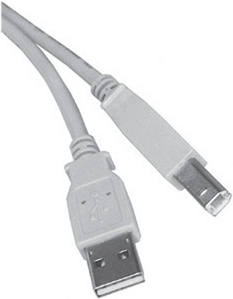
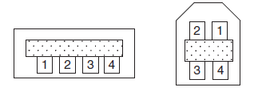
The figures shown below represent USB connectors and pin-out of USB connectors.
The signal wire connectors are specified w.r.t two types of connectors i.e. Type A and Type B.
The pins and wire colors of a Type A or Type B connector are given in table shown below.
USB connectors
Print-out of USB connectors

Slide 8
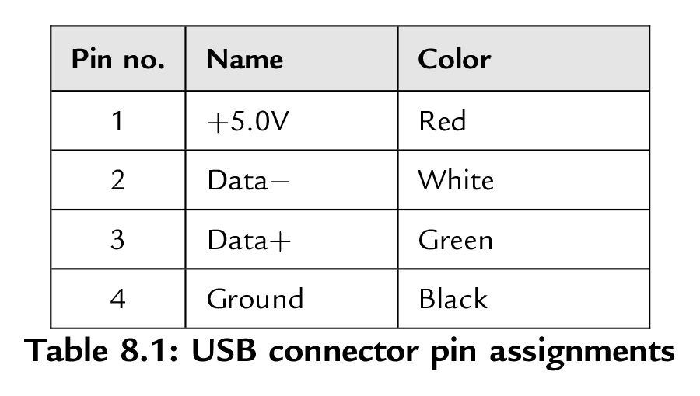
USB connector pin assignments
There is also a connector named as mini-B connector mainly used in portable electronic devices such as cameras and other handheld devices.
This connector differs from the original w.r.t pin configuration i.e. it has fifth pin which is not used.

Slide 9
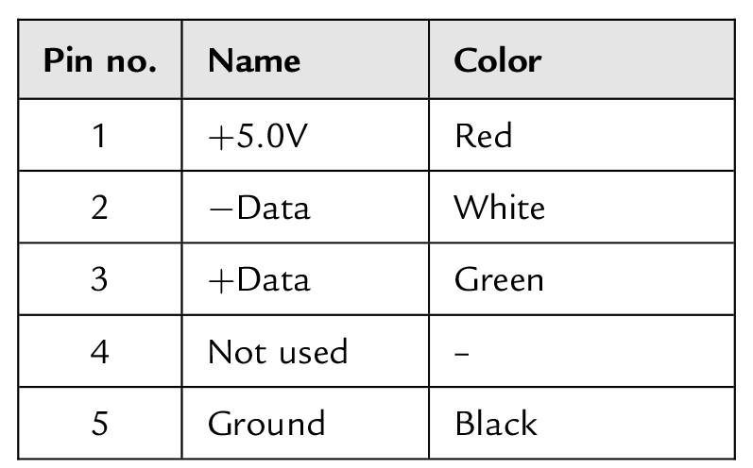
The pin assignments and wire colors are shown in the table below.
As seen in the table there are two pins namely Data + and Data -. These pins form a twisted pair and carry differential data signals.
Mini USB connector pin assignments

Slide 10
Differential signaling is a method for electrically transmitting information using two complementary signals. The technique sends the same electrical signal as a differential pair of signals.
The receiving circuit responds to the electrical difference between the two signals, rather than the difference between a single wire and ground.

Slide 11
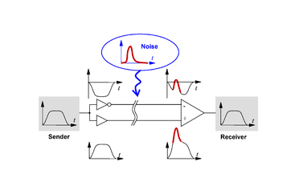

Slide 12
USB signals are bi-phase and the signals from the host computer are sent using NRZI data encoding technique.
Bi-phase signals are those signals which used two opposite signal phases i.e. 0i-180i. For example, the phase shift could be 0i for encoding a 0 and 180i for encoding a 1 or the phase shift could be -90i for a 0 and +90i for a 1.
In either case the phase shift between those two signals will be 180i apart.

Slide 13
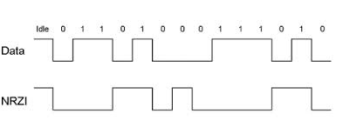
In this NRZI technique, the signal level is inverted for each change to a logic 0 and does not change for a logic 1.
To make the data dynamic, bit stuffing is done i.e. a bit ‘0’ is stuffed in the data after every six consecutive 1’s.
Bit stuffing lengthens the data stream. The figure shown below shows how the NRZI data is encoded.

Slide 14
Host transmits a packet of data to every device connected to the bus which travels downwards through a chain of bus.
All the devices receive the signal but the one that is addressed accepts the data.
Only one device at any time can transmit to the host and the data travels upwards through the chain of hubs until it reaches the host.
USB devices attached to the bus may be full custom devices requiring a full custom device driver or they may belong to a device class.

Slide 15
Device classes enable the same device driver to be used for several devices having similar functionalities.
For example, a printer device has the device class 007, and most printers use drivers of this type.
The most common device classes are given in table shown below. The most commonly used device class for example purpose is USB human interface device (HID).

Slide 16
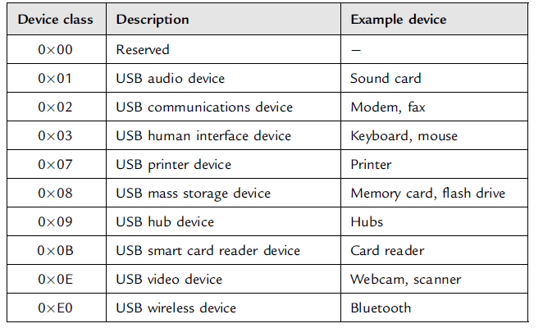
USB Device classes

Slide 17
Common USB terms:
Endpoint: An endpoint is either a source or a sink of data. A single USB device can have a number of endpoints, the limit being sixteen IN and sixteen OUT endpoints.
Transaction: A transaction is a transfer of data on the bus.
Pipe: A pipe is a logical data connection between the host and an endpoint.

Slide 18
USB BUS COMMUNICATION:
The system connectivity in USB defines a host centric connection where in host initiates the USB related transactions.
Each device on the bus has a unique USB address which and assertion of a signal cannot be done by the slave device until the host asks for it.
When a new USB bus is plugged into a bus, the USB host address 0 asks the basic information from the device.

Slide 19
The information that is asked is assigned to a unique USB address which is done by the host.
The host asks further information about the device like name of the manufacturer, device capabilities, and product ID.
Once all these information has been received then the USB begins the two-way transactions.

Slide 20
SPEED IDENTIFICATION ON THE BUS
At the device end of the bus, a 1.5K pull-up resistor is connected from the D+ or D- line to 3.3V.
On a full-speed bus, the resistor is connected from the D+ line to 3.3V, and on a low-speed bus the resistor is from D- line to 3.3V.
When no device is plugged in, the host will see both data lines as low.
Connecting a device to the bus will pull either the D+ or the D- line to logic high, and the host will know that a device is plugged into the bus.
The speed of the device is determined by observing which line is pulled high.

Slide 21
USB STATES
There are some states that USB will depend upon.
Idle: Idle state is the one which will be present before and after transmission of packet. When the pulled-up line is high and the other line is low then the bus is said to be in idle state.
Detached: The host decides both the lines to be low when no device is connected to the bus.
Attached: When a device is connected to the bus then the host sees the logic lines D+ or D- go high.

Slide 22
J State: This is same as idle state. This is the special terminology used to talk about the state of USB lines. The J state is the same polarity to the idle state (the line with pull-up resistor is high and the other line is low) but is being driven to that state either by host or device.
K State: This state is opposite polarity to that of J state.
SE0 & SE1: SE0 state is nothing but single ended zero state where both lines on the bus are pulled low. SE1 state indicate Single Ended one state where both lines are high.

Slide 23
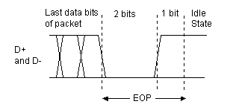
NOTE: SE1 state should never be present as it is illegal condition on the bus.
Reset: For communication between device and bus host sends a reset condition which will be activated by pulling both the data lines low (SE0 State) for at-least 10ms.
EOP: EOP stands for End of Packet which is an SE0 state for 2 bit times followed by a J state for 1 bit time.

Slide 24
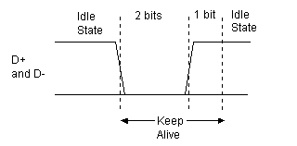
Keep Alive: This is represented by a low speed EOP. It is sent for every one millisecond on a low speed link in order to keep the device from suspending.
Suspend: This is used to save power which can be implemented by not sending anything to a device for 3ms. A suspended device draws less than 0.5mA from the bus and must recognize reset and resume signals.

Slide 25
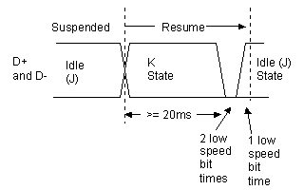
Resume: A suspended device is woken up by reversing the polarity of the signal on the data lines for at least 20ms, followed by a low-speed EOP signal.

Slide 26
Packets:
The data transmission is done in the form of packets on a USB bus.
The data synchronization is achieved with respect to receiver clock when a packet starts with a sync pattern.
After the sync pattern the data bytes will follow ending with an end of packet signal.
The data bytes will be stored in the form of an identifier known as Packet Identifier (PID) byte.

Slide 27
A PID is four bits long and remaining four bits are repeated in a complemented form.
There are seventeen different PID values as shown in the table below. These include one reserved value and bits with same representation with different PID names that is used twice with two different meanings.
There are four packet formats based on which PID is at the start of the packet i.e. token packets, data packets, handshake packets, and special packets.

Slide 28
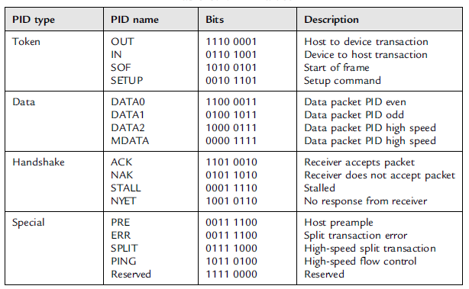
PID Values

Slide 29
The figure shown below is the format of a token packet which is used for OUT, IN, SOF, and setup.
The packet contains a 7-bit address, a 4-bit ENDP (end point number), a 5-bit CRC checksum, and an EOP (end of packet).\
A data packet is used for DATA0, DATA1, DATA2, and MDATA data transactions.

Slide 30
The packet format is shown in the figure below.
The packet format of a handshake is shown below. This is used for ACK, NAK, STALL, and NYET.
Handshake refers to exchange of standardized signals between devices in a computer network regulating the transfer of data.

Slide 31
ACK is used when the receiver acknowledges that the packet of data is received without any error.
When a function is unable to transmit or receive data then NAK handshake packet is used.
STALL indicates when the endpoint is halted. STALL handshake packet indicates that the data can be neither transmitted nor received.
When a STALL handshake packet is issued the function’s endpoint are in a halted state. Host should never issue a STALL handshake packet.

Slide 32
NYET is used when there is no response from the receiver.
Data Flow Types:
The data transfer on a USB can be done in four ways i.e. bulk transfer, interrupt transfer, isochronous transfer, and control transfer.

Slide 33
Large amounts of data without any errors has
been transferred with this bulk transfer.
The data transfers in this bulk transfer is done based on endpoints. If OUT endpoint is defined using bulk transfers, then the host will transfer data to it using OUT transactions.
Similarly if an IN endpoint is defined using bulk transfers, then the host will transfer data from it using IN transactions.
The maximum packet size in a bulk transfer is 8 to 64 packets at full speed, and 512 packets at high speed (bulk transfers are not allowed at low speeds).

Slide 34
If the data has to be transferred at a faster rate with no delay, then interrupt transfers can be used.
In this interrupt transfers small amount of data can be transferred with high bandwidth. The word interrupt is not similar to the word used in computer systems.
Interrupt packets can range in size from 1 to 8 bytes at low speed, from 1 to 64 bytes at full speed, and up to 1024 bytes at high speed.

Slide 35
Isochronous transfers have a guaranteed bandwidth but error free delivery is not guaranteed.
This type of transfer is generally used in applications, like audio data transfer where speed is important but the loss of data can be ignored.
An isochronous packet may contain 1023 bytes at full speed or up to 1024 bytes at high speed (isochronous transfers are not allowed at low speeds).

Slide 36
Control transfer is a bi-directional data transfer using both IN and OUT endpoints.
Control transfers are generally used for initial configuration of a device by the host.
The maximum packet size is 8 bytes at low speed, 8 to 64 bytes at full speed, and 64 bytes at high speed.
A control transfer is carried out in three stages: SETUP, DATA, and STATUS.

Slide 37
Enumeration:
Enumeration is a process that is used to make the host know about a device when it is plugged into a USB bus.
Steps of Enumeration:
When a device is plugged in, the host will be able to know about that device because one of the data lines (D+ or D-) becomes logic high.
The device can be placed in a known state when the host sends a USB reset signal. The reset device responds to address 0.

Slide 38
Using a Get Descriptor command, the host sends a request on address 0 to the device to find out its maximum packet size.
The device sends small portion of devicedescriptor and responds to the host.
The host sends a USB reset again.
Set Address Request command is sent by the host to the device so that a unique address is assigned to the device.
After the request is made, the device assumes the new address.
Once the device assumes new address the host is free to reset any other newly plugged in devices on the bus.

Slide 39
The host sends a Get Device Descriptor request to retrieve the complete device descriptor, gathering information such as manufacturer, type of device, and maximum control packet size.
The host sends a Get Configuration Descriptors request to receive the device’s configuration data, such as power requirements and the types and number of interfaces supported.
The host may request any additional descriptors from the device.
The host and the device initial communication is carried out using control transfer type of data flow.

Slide 40
After the device is addressed, the device will not be ready to function. It will be in an un-configured state.
Once the host gathers suitable information about the device, the device can be configured by loading a device driver which suits the device. This is done by Set Configuration request.
After the request is sent, the device has been configured. Then it is ready to respond to device specific requests (can receive data from and send data to the host.)

Slide 41
DESCRIPTORS
There are a hierarchy of descriptors that each and every USB device will have.
These descriptors describe various features of the device like the manufacturer ID, the version of the device, the version of USB it supports, what the device is, its power requirements, the number and type of endpoints etc.
The most common USB descriptors are listed below.

Slide 42
Device descriptors.
Configuration descriptors.
Interface descriptors.
HID descriptors
Endpoint descriptors.
The hierarchical structure of the descriptors is shown in the figure below.
As seen in the diagram, at the top of the hierarchy device descriptor is present followed by configuration descriptor, interface descriptor and finally endpoint descriptor.

Slide 43
The HID descriptor always follows the interface descriptor when the interface belongs to the HID class.
There is a common format for all the descriptors i.e. the first byte (bLength) specifies the length of the descriptor and the second byte (bDescriptorType) indicates the descriptor type.

Slide 44
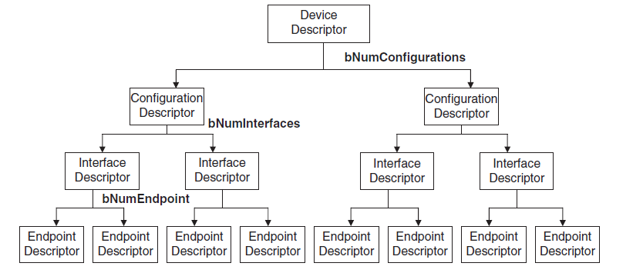
USB descriptor hierarchy

Slide 45
Device Descriptor:
Device descriptor is the top-level set of information read from a device and the first item the host attempts to retrieve.
The device descriptor represents the entire device and so USB has only one device descriptor.
General information such as manufacturer, serial number, product number, class of the device, and number of configurations is present with device descriptor.

Slide 46
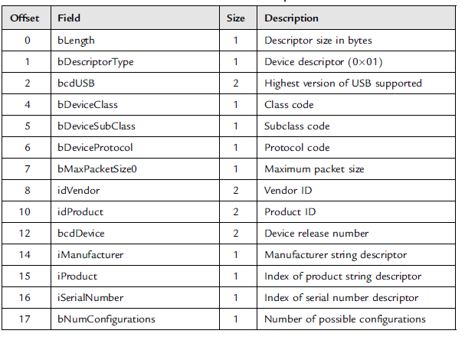
The table below shows the format of device descriptor with the meaning of each field.

Slide 47
bLength is the length of the device descriptor.
bDescriptor Type is the descriptor type.
The bcdUSB field reports the highest version of USB the device supports.
The value is in binary coded decimal with a format of 0xJJMN where JJ is the major version number, M is the minor version number and N is the sub minor version number.
e.g. USB 2.0 is reported as 0x0200, USB 1.1 as 0x0110 and USB 1.0 as 0x0100.

Slide 48
bDeviceClass, bDeviceSubClass, and bDevice Protocol are assigned by the USB organization.
They are used by the operating system to find a class driver for our device.
The bMaxPacketSize field reports the maximum packet size for endpoint zero.
All devices must support endpoint zero.
idVendor and idProduct are assigned by the USB organization and manufacturer respectively.
They represent the vendor’s ID and product ID.

Slide 49
bcdDevice is the device release number and has the same format as the bcdUSB.
iManufacturer, iProduct, and iSerialNumber provide details about the manufacturer and the product. These fields have no requirement and can be set to zero.
bNumConfigurations is the number of configurations the device supports.
The table shown below is the device descriptor for a mouse device which is considered as an example.

Slide 50
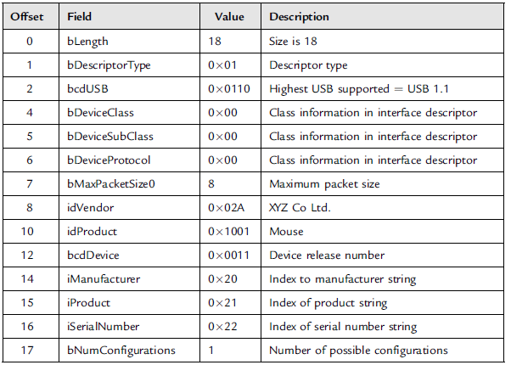
Example device descriptor

Slide 51
The length of the descriptor is 18 bytes (bLength = 18), and the device descriptor type is 0x01 (bDescriptor Type = 0x01).
The device supports USB 1.1 and so bcdUSB is given as 0x0110.
bDeviceClass, bDeviceSubClass, and bDevice Protocol are set to zero to show that the class information is in the interface descriptor.
bMaxPacketSize0 is set to 8 to show that the maximum input and output packet size for endpoint 0 is 8 bytes.

Slide 52
The next three bytes i.e. vendor ID, product ID and device version number indentify the device.
The next three items define indexes to strings about the manufacturer, product, and the serial number.
Finally, we can see that the mouse device has only one configuration i.e.
bNumConfigurations = 1.

Slide 53
Configuration Descriptors:
The configuration descriptor provides information about the power requirements of the device and how many different interfaces it supports.
A device can have more than one configuration.
The table shown below shows the format of the configuration descriptor.

Slide 54
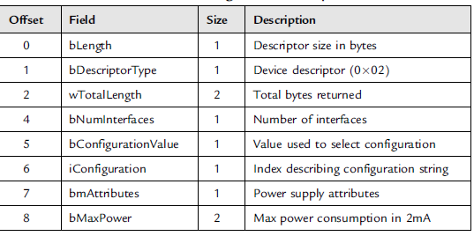
bLength is the length of the device descriptor.
bDescriptor Type is the descriptor type.
Configuration descriptor

Slide 55
wTotalLength is the total combined size of this set of descriptors (i.e., total of configuration descriptor + interface descriptor + HID descriptor + endpoint descriptor).
When the configuration descriptor is read by the host, it returns the entire configuration information which includes all interface and endpoint descriptors.
bNumInterfaces is the number of interfaces present for this configuration.
bConfigurationValue is used by the host (in command SetConfiguration) to select the configuration.

Slide 56
iConfiguration is an index to a string descriptor describing the configuration in readable format.
bmAttributes describes the power requirements of the device.
If the device is USB bus-powered, then bit D7 is set. If it is self-powered, it sets bit D6.
Bit D5 specifies the remote wakeup of the device. Bits D7 and D0–D4 are reserved.
bMaxPower defines the maximum power the device will draw from the bus in 2mA units.

Slide 57
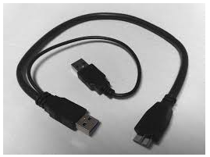
The table shown below shows an example configuration descriptor for a mouse device.

Slide 58
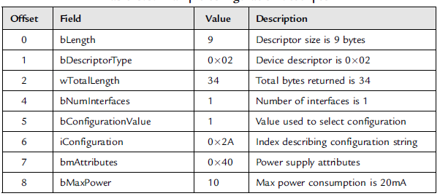

Slide 59
The length of the descriptor is 9 bytes (bLength= 9), and the descriptor type is 0x02 (bDescriptorType = 0x02).
The total combined size of the descriptors is 34 (wTotalLength = 34).
The number of interfaces for the mouse device is 1 (bNumInterfaces = 1).
Host SetConfiguration command must use the value 1 as an argument in SetConfiguration() to select this configuration.

Slide 60
bmAttributes is set to 040 to indicate that the device is self-powered.
bMaxPower is set to 10 to specify that the maximum current drawn by the device is 20mA.

Slide 61
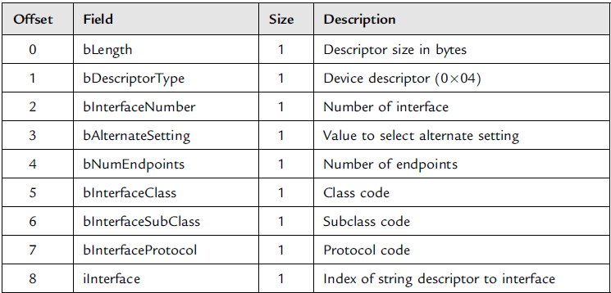
Interface Descriptors:
The interface descriptors specify the class of interface and the number of end points it uses. There may be more than one interface.
The table shown below shows the format of the interface descriptor with the meaning of each field.

Slide 62
bLength indicates the length of the device descriptor.
The descriptor type is given by bDescriptorType.
The interface descriptor’s index is given by bInterfaceNumber.
bAlternateSetting can be used to specify alternate interfaces that can be selected by the host using command Set Interface.
The number of end points used by the interface can be indicated by bNumEndpoints.
bInterfaceClass specifies the device class code (assigned by the USB organization).
bInterfaceSubClass specifies the device subclass code (assigned by the USB organization).

Slide 63
bInterfaceProtocol specifies the device protocol code (assigned by the USB organization).
The string descriptor’s interface can be determined by iInterface which is an index to a string descriptor. String descriptor provide human readable information.
The table shown below shows an example interface descriptor for a mouse device.
As seen in the table the descriptor length is 9 bytes, descriptor type is 0x04 (bDescriptorType = 0x04), and the interface number used to reference this interface is 1 (bInterfaceNumber=1 ).

Slide 64
bAlternateSetting is set to 0 (i.e., no alternate interfaces).
The number of endpoints used by this interface is 1 (excluding endpoint 0), and this is the endpoint used for the mouse to send its data.
The device class code is 0x03 (bInterfaceClass = 0x03).
This is an HID (human interface device) type class.
The interface subclass is set to 0x02.
The device protocol is 0x02 (mouse).
There is no string to describe this interface (iInterface = 0).

Slide 65
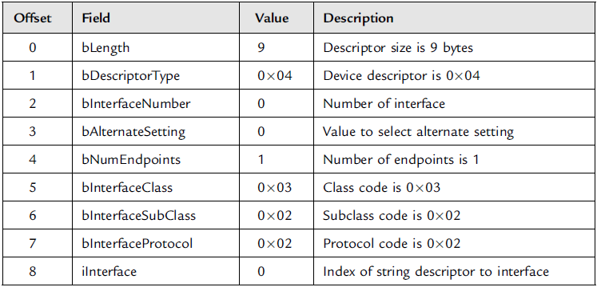

Slide 66
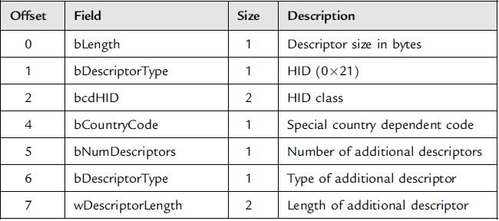
HID Descriptors:
In the interface descriptor when the interface belongs to HID class then HID descriptor will come.
The format of the HID descriptor is shown in the table below.

Slide 67
bLength indicates the length of the descriptor.
The descriptor type is indicated by bDescriptorType.
HID class specification is given by bcdHID.
If any special local changes have been made then they can be specified by bCountryCode.
The additional descriptors associated with this class is given by bNumDescriptors.
If any additional descriptor is specified in bNumDescriptors then that can be defined by bDescriptorType.
The length of the additional descriptor in bytes can be represented by wDescriptorLength.

Slide 68
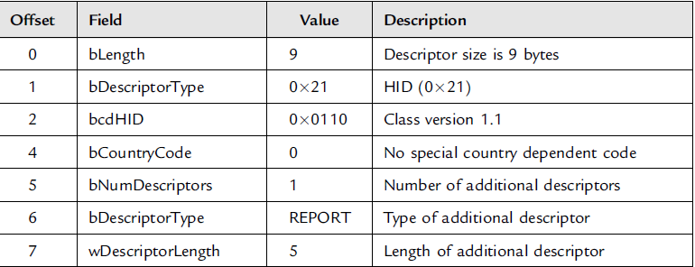
The table shown below is an example for HID descriptor for a mouse device.

Slide 69
As seen in the above table, the length of the descriptor is 9 bytes (bLength=9).
The descriptor type is 0x21 (bDescriptorType=0x21). The HID class is set to 1.1 (bcdHID = 0x0110).
The country code is set to zero (bCountryCode=0), which indicates that there is no special localization with this device.
The number of descriptors is set to 1 (bNumDescriptors=1) which specifies that there is one additional descriptor associated with this class.
The type of the additional descriptor is REPORT (bDescriptorType = REPORT) .
The length of the additional descriptor is 52 bytes (wDescriptorLength = 52).

Slide 70
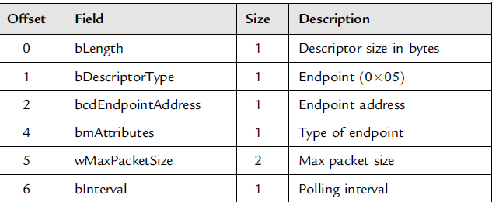
Endpoint Descriptor
The table shown below is the format for endpoint descriptor.
The endpoint is a device or node that is connected to the LAN or WAN and accepts communications back and forth across the network. In a traditional sense, an endpoint can be a modem, hub, bridge, or switch.
It also could be data terminal equipment (such as a digital telephone handset, router, or printer) or a host computer (such as a workstation or a server).

Slide 71
As seen in the above table the length of the device descriptor is indicated by bLength.
The descriptor type and the address of the endpoint are given by bDescriptorType and bEndpointAddress respectively.
The type of endpoint is specified by bmAttributes.
The maximum packet size is indicated by wMaxPacketSize.
bInterval specifies how often the endpoint should be polled (in ms).

Slide 72
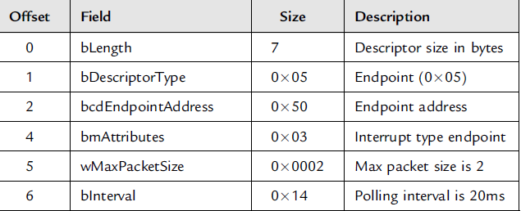
The table shown below is an example of endpoint descriptor for a mouse device.

Slide 73
PIC18 MICROCONTROLLER USB BUS INTERFACE
Some of the PIC microcontrollers support USB interface directly. For e.g., the PIC18F4550 microcontroller contains a full speed and low speed compatible USB interface that allows communication between a host PC and a microcontroller.
The figure shown below is an USB section of the PIC18F4550 microcontroller.
The microcontroller pin diagram is shown below (http://www.engineersgarage.com/electronic-components/pic18f4550-microcontroller).

Slide 74
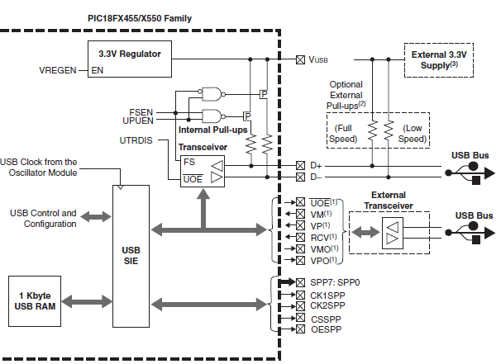
PIC18 Microcontroller USB overview

Slide 75
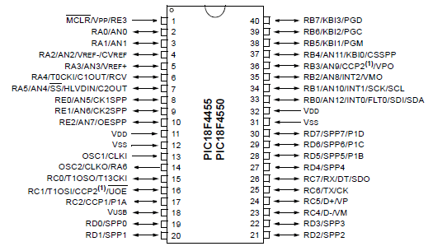

Slide 76
Port C pins i.e. RC4 (pin 23) and RC5 (pin 24) are used for USB interface. RC4 is the USB data D- pin while RC5 is the USB data D+ pin.
The internal pull-up resistors can be disabled (if required) setting UPUEN = 0 and external pull-up resistors can be used instead.
For full-speed operation an internal or external resistor should be connected to data pin D+, and for low-speed operation an internal or external resistor should be connected to data pin D.
Operation of the USB module is configured using three control registers, and a total of twenty-two registers are used to manage the actual USB transactions.

Slide 77
CAN BUS
Introduction
CAN Stands for Controller Area Network which is a serial bus communication protocol.
CAN bus has been developed by Bosch (an electrical equipment manufacturer in Germany) in the early 1980’s.
Later CAN was standardized as ISO-11898 and ISO-11519 which has been established as a standard protocol for in-vehicle networking in the auto industry.
In the earlier days before CAN was introduced, some localized stand alone controllers have been used to manage various actuators and electromechanical sub-systems in the automotive industry.

Slide 78
Applying the concept of networking to electronics through CAN , the vehicle parts can be controlled from a central point known as Engine Control Unit (ECU).
This increased modularity, functionality, and making diagnostic processes more efficient.
Earlier CAN was mainly supported by vehicle industry. But today CAN protocol is used in many other fields like industrial automation, medical applications, building automation, weaving machines, and production machinery.
CAN offers an efficient communication protocol between sensors, actuators, controllers, and other nodes in real-time applications, and is known for its simplicity, reliability, and high performance.

Slide 79
CAN protocol is based on bus topology and only two wires are needed for communication over a CAN bus.
The bus has a multi-master structure where each device on the bus can send or receive data.
Only one device can send the data at any time while all others will be in listening mode.
If two or more devices attempt to send data at a time then the one with the highest priority will be sent first and others in receive mode.
As shown in the figure below in a typical vehicle application there is usually one or more CAN bus that operate at different speeds.
Slower devices, such as door control, climate control, and driver information modules, can be connected to a slow speed bus.
Devices that require faster response, such as the ABS antilock braking system, the transmission control module, and the electronic throttle module, are connected to a faster CAN bus.

Slide 80
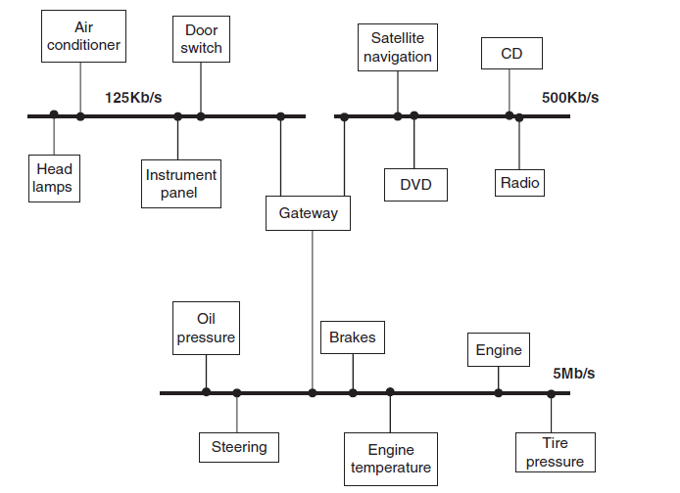

Slide 81
The automotive use of CAN bus has caused mass production of CAN controllers.
The estimation is that 400 million CAN controllers are sold every year and CAN controllers are integrated on many microcontrollers including PIC microcontrollers which are available at low cost.
The figure below shows a CAN bus with three nodes. CAN protocol is based on CSMA/CD+AMP (Carrier-Sense Multiple Access/Collision Detection with Arbitration on Message Priority) protocol which is similar to the protocol used in Ethernet LAN.
When Ethernet detects a collision, the sending nodes stop transmitting and wait a random amount of time before trying to send again.
CAN protocol can solve the problem of collision using the principle of arbitration where only highest priority node is given the right to send the data.

Slide 82
There are basically two types of CAN protocols: CAN 2.0A and CAN 2.0B.
CAN 2.0A is the earlier standard with 11 bits of identifier while CAN 2.0B is the new extended standard with 29 bits of identifier.
2.0B controllers are completely backward-compatible with 2.0A controllers and can receive and transmit messages in either format.
Backward compatible refers to a hardware or software system that can use the interface of an older version of the same product.
A new standard product or model is considered backward compatible when it is able to read, write or view older formats.
2.0A controllers are of two types. The first type is capable of sending and receiving 2.0A messages only.
The reception of 2.0B will flag an error. The second type of 2.0A controller which is also known as 2.0B passive does two functions.

Slide 83
The two functions that can be done are it sends and receives 2.0A messages and also will acknowledge receipt of 2.0B messages and then ignore them.
Features of CAN protocol:
CAN bus is multimaster i.e. when the bus is free any device attached to the bus can start sending a message.
CAN bus protocol is flexible. The devices connected to the bus have no addresses, which means messages are not transmitted from one node to another based on addresses.
Instead, all nodes in the system receive every message transmitted on the bus, and it is up to each node to decide whether the received message should be kept or discarded.
A single message can be destined for a particular node or for many nodes, depending on how the system is designed.

Slide 84
CAN bus offers remote transmit request (RTR), which means that one node on the bus is able to request information from the other nodes.
Thus instead of waiting for a node to continuously send information, a request for information can be sent to the node.
For example, in a vehicle, where the engine temperature is an important parameter, the system can be designed so the temperature is sent periodically over the bus.
However, a more elegant solution is to request the temperature as needed, since it minimizes the traffic while maintaining the network’s integrity.
CAN bus communication speed is not fixed. Any communication speed can be set for the devices attached to a bus.
All devices on the bus can detect an error. The device that has detected an error immediately notifies all other devices.

Slide 85
Multiple devices can be connected to the bus at the same time, and there are no logical limits to the number of devices that can be connected.
In practice, the number of units that can be attached to a bus is limited by the bus’s delay time and electrical load.

Slide 86
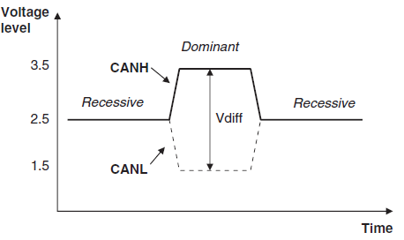
The data on CAN bus is differential and can be in two states: dominant and recessive. The figure below shows the state of voltages on the bus.
CAN logic states

Slide 87
The bus defines a logic bit 0 as a dominant bit and a logic bit 1 as a recessive bit.
When there is arbitration (disagreement) on the bus, a dominant bit state always wins out over a recessive bit state.
In the recessive state, the differential voltage CANH and CANL is less than the minimum threshold (i.e., less than 0.5V receiver input and less than 1.5V transmitter output).
In the dominant state, the differential voltage CANH and CANL is greater than the minimum threshold.
The ISO-11898 CAN bus specifies that a device on that bus must be able to drive a forty-meter cable at 1Mb/s.
A much longer bus length can usually be achieved by lowering the bus speed.
The figure below shows the variation of bus length with the communication speed.

Slide 88
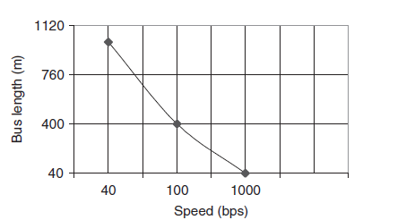
For example, with a bus length of one thousand meters we can have a maximum speed of 40Kb/s.
CAN bus speed and bus length

Slide 89
The signal reflections on the bus can be minimized by terminating a CAN bus.
Signal reflection occurs when a signal is transmitted along a transmission medium, such as a copper cable or an optical fiber.
Some of the signal power may be reflected back to its origin rather than being carried all the way along the cable to the far end.
The IS0-11898 requires that the bus has a characteristic impedance of 120 ohms.
The bus termination can be done by any one of the following methods:
Standard termination
Split termination
Biased split termination.

Slide 90
Standard Termination:
This is considered to be the most common termination method which consist of a 120 ohms resistor at each end of the bus.
Split Termination:
In split termination, the ends of the bus are split and a single 60-ohm resistor is used.
Split termination allows for reduced emission, and this method is gaining popularity.
Biased Split Termination:
Biased Split Termination is similar to split termination which uses a biased voltage divider circuit and a capacitor is used at the end of the bus.

Slide 91
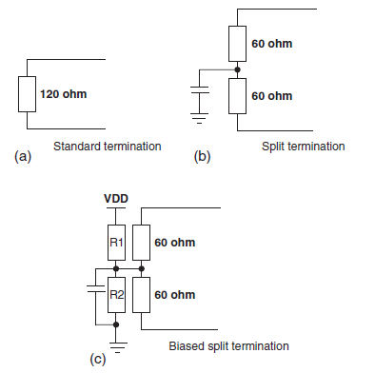
Bus termination methods

Slide 92
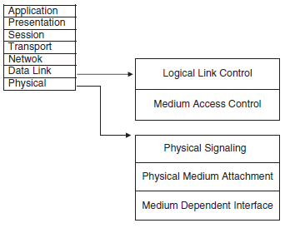
The most commonly used networking layer is the seven layer Open Systems Interconnection (OSI) model.
The CAN protocol includes the data link layer and physical layer of the OSI reference model.
CAN and OSI model

Slide 93
The data link layer (DLL) consists of the Logical Link Control (LLC) and Medium Access Control (MAC).
LLC manages the overload notification, acceptance filtering (accepting messages by filtering process), and recovery management.
MAC manages the data encapsulation (sending data where the data is augmented with successive layers of control information before transmission across a network. ), frame coding, error detection and serialization/deserialization of data.
A frame is a digital data transmission unit in computer networking and telecommunication.

Slide 94
A frame typically includes frame synchronization features consisting of a sequence of bits or symbols that indicate to the receiver the beginning and end of the payload data within the stream of symbols or bits it receives.
Serialization refers to the process of taking a network of objects and their member data, and turning it into a linear byte stream; deserialization refers to the opposite.

Slide 95
Message Frames in CAN protocol:
There are basically four message frames in CAN: data, remote, error, and overload. The data and remote frames need to be set by the user.
The other two are set by the CAN hardware.
Data Frame:
The data frame is in two formats: standard (having an 11-bit ID) and extended (having a 29-bit ID).
The data frame is used by the transmitting device to send data to the receiving device, and the data frame is the most important frame handled by the user.
The figure shown below indicate the structures of standard data frame and extended data frame.

Slide 96
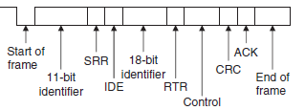
Standard Data Frame
Extended Data Frame

Slide 97
A standard data frame starts with the start of frame (SOF) bit, which is followed by an 11-bit identifier and the remote transmission request (RTR) bit.
The identifier and the RTR form the 12-bit arbitration field. The control field is 6 bits wide and indicates how many bytes of data are in the data field. The data field can be 0 to 8 bytes.
The data field is followed by the CRC field, which checks whether or not the received bit sequence is corrupted.
The ACK field is 2 bits and is used by the transmitter to receive acknowledgment of a valid frame from any receiver. The end of the message is indicated by a 7-bit end of frame (EOF) field.
In an extended data frame, the arbitration field is 32 bits wide (29-bit identifier +1-bit IDE to define the message as an extended data frame +1-bit SRR which is unused +1-bit RTR).

Slide 98
The data frame consists of the following fields:
Start of Frame (SOF): The start of frame field indicates the beginning of a data frame and is common to both standard and extended formats.
Arbitration Field:
Arbitration is used to resolve bus conflicts that occur when several devices at once start sending messages on the bus.
The arbitration field indicates the priority of a frame, and it is different in the standard and extended formats.
In the standard format there are 11 bits, and up to 2032 IDs can be set. The extended format ID consists of 11 base IDs plus 18 extended IDs. Up to 2032x 2¹⁸ discrete IDs can be set.
During the arbitration phase, each transmitting device transmits its identifier and compares it with the level on the bus.

Slide 99
If the levels are equal, the device continues to transmit. If the device detects a dominant level on the bus while it is trying to transmit a recessive level, it quits transmitting and becomes a receiving device.
After arbitration only one transmitter is left on the bus, and this transmitter continues to send its control field, data field, and other data.
The process of arbitration is illustrated in figure by an example consisting of three nodes having identifiers: Node 1: 11100110011; Node 2: 11100111111; Node 3: 11100110001

Slide 100
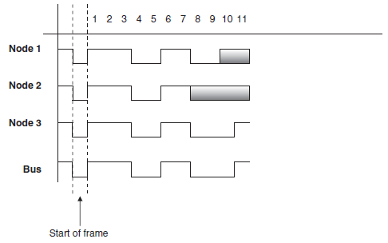
Example CAN bus arbitration

Slide 101
Assuming the recessive level corresponds to 1 and the dominant level to 0, the arbitration is performed as follows:
All the nodes start transmitting simultaneously, first sending SOF bits.
Then they send their identifier bits. The 8th bit of Node 2 is in the recessive state, while the corresponding bits of Nodes 1 and 3 are in the dominant state.
Therefore Node 2 stops transmitting and returns to receive mode. The receiving phase is indicated by a gray field.
The 10th bit of Node 1 is in the recessive state, while the same bit of Node 3 is in dominant state.
Thus Node 1 stops transmitting and returns to receive mode.
The bus is now left to Node 3, which can send its control and data fields freely.

Slide 102
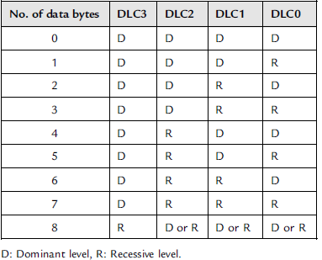
Control Field:
The control field is 6 bits wide, consisting of 2 reserved bits and 4 data length code (DLC) bits, and indicates the number of data bytes in the message being transmitted.
This field is coded as shown in table below, where up to 8 transmit bytes can be coded with 6 bits.

Slide 103
Data Field:
The data field carries the actual content of the message. The data size can vary from 0 to 8 bytes. The data is first transmitted with the MSB.
CRC Field:
The CRC field, consisting of a 15-bit CRC sequence and a 1-bit CRC delimiter, is used to check the frame for transmission error.
The CRC calculation includes the start of frame, arbitration field, control field, and data field.
The calculated CRC and the received CRC sequence are compared, and if they do not match, an error is assumed.
ACK Field:
The ACK field indicates that the frame has been received normally. This field consists of 2 bits, one for ACK slot and one for ACK delimiter.

Slide 104
The delimiters are used to give all nodes some time to work on and react to the previous bits.
Receiving nodes get one bit time (CRC delimiter) to compare the CRC calculated internally on the received data with the CRC received in the frame.
They then have one bit time (ACK delimiter) to complete CRC calculation and one bit time (ACK slot) to acknowledge that they received data frame.

Slide 105
Remote Frame
The remote frame is used by the receiving unit to request transmission of a message from the transmitting unit.
It consists of six fields as shown in the figure below.
Start of frame, arbitration field, control field, CRC field, ACK field, and end of frame field. A remote frame is the same as a data frame except that it lacks a data field.

Slide 106
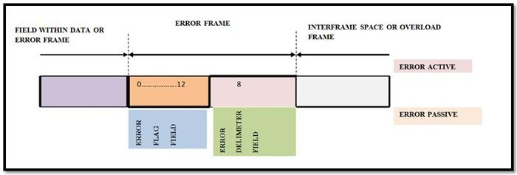
Error Frame
Error frames are generated and transmitted by the CAN hardware and are used to indicate when an error has occurred during transmission.
An error frame consists of an error flag and an error delimiter.
There are two types of error flags: active, which consists of 6 dominant bits, and passive, which consists of 6 recessive bits.
The error delimiter consists of 8 recessive bits.

Slide 107
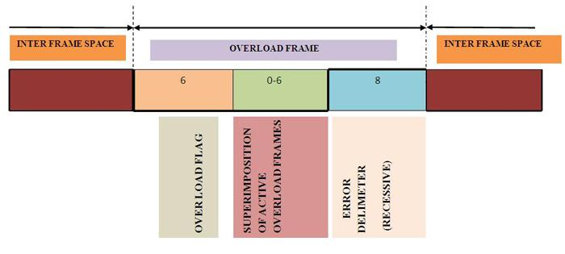
Overload Frame
The overload frame is used by the receiving unit to indicate that it is not yet ready to receive frames.
This frame consists of an overload flag and an overload delimiter.
The overload flag consists of 6 dominant bits and has the same structure as the active error flag of the error frame.
The overload delimiter consists of 8 recessive bits and has the same structure as the error delimiter of the error frame.

Slide 108
Bit Stuffing
The CAN bus makes use of bit stuffing, a technique to periodically synchronize transmit-receive operations to prevent timing errors between receive nodes.
After 5 consecutive bits with the same level, one bit of inverted data is added to the sequence.
If, during sending of a data frame or remote frame, the same level occurs in 5 consecutive bits anywhere from the start of frame to the CRC sequence, an inverted bit is inserted in the next (i.e., the sixth) bit.
If, during receiving of a data frame or remote frame, the same level occurs in 5 consecutive bits anywhere from the start of frame to CRC sequence, the next (sixth) bit is deleted from the received frame.
If the deleted sixth bit is at the same level as the fifth bit, an error (stuffing error) is detected.

Slide 109
Types of Errors:
The CAN bus identifies five types of errors:
Bit error
CRC error
Form error
ACK error
Stuffing error
Bit errors are detected when the output level and the data level on the bus do not match. Both transmit and receive units can detect bit errors.
CRC errors are detected only by receiving units. CRC errors are detected if the calculated CRC from the received message and the received CRC do not match.
Form errors are detected by the transmitting or receiving units when an illegal frame format is detected.

Slide 110
ACK errors are detected only by the transmitting units if the ACK field is found recessive.
Stuffing errors are detected when the same level of data is detected for 6 consecutive bits in any field that should have been bit-stuffed.
This error can be detected by both the transmitting and receiving units.
Nominal Bit Timing:
The CAN bus nominal bit rate is defined as the number of bits transmitted every second without resynchronization.
The inverse of the nominal bit rate is the nominal bit time.
All devices on the CAN bus must use the same bit rate, even though each device can have its own different clock frequency.

Slide 111
One message bit consists of four nonoverlapping time segments:
Synchronization segment (Sync_Seg)
Propagation time segment (Prop_Seg)
Phase buffer segment 1 (Phase_Seg1)
Phase buffer segment 2 (Phase_Seg2)
The Sync_Seg segment is used to synchronize various nodes on the bus, and an edge is expected to lie within this segment.
The Prop_Seg segment compensates for physical delay times within the network.
The Phase_Seg1 and Phase_Seg2 segments compensate for edge phase errors.

Slide 112
The sample point is the point in time where the actual bit value is located and occurs at the end of Phase_Seg1.
A CAN controller can be configured to sample three times and use a majority function to determine the actual bit value.
Each segment is divided into units known as time quantum, or TQ.
A desired bit timing can be set by adjusting the number of TQ’s that comprise one message bit and the number of TQ’s that comprise each segment in it.
The TQ is a fixed unit derived from the oscillator period, and the time quantum of each segment can vary from 1 to 8.
The lengths of the various time segments are:
Sync_Seg is 1 time quantum long
Prop_Seg is programmable as 1 to 8 time quanta long
Phase_Seg1 is programmable as 1 to 8 time quanta long
Phase_Seg2 is programmable as 2 to 8 time quanta long

Slide 113
By setting the bit timing, a sampling point can be set so multiple units on the bus can sample messages with the same timing.
The nominal bit time is programmable from a minimum of 8 time quanta to a maximum of 25 time quanta.
By definition, the minimum nominal bit time is 1ms, corresponding to a maximum 1Mb/s rate.
The nominal bit time (TBIT) is given by:
and the nominal bit rate (NBR) is

Slide 114
The time quantum is derived from the oscillator frequency and the programmable baud rate prescaler, with integer values from 1 to 64.
The time quantum can be expressed as:
where TQ is in ms, FOSC is in MHz, and BRP is the baud rate prescaler (0 to 63).
The above equation can be written as

Slide 115
Example problem:
Assuming a clock frequency of 20MHz, a baud rate prescaler value of 1, and a nominal bit time of TBIT = 8 * TQ, determine the nominal bit rate.
Solution:
Using equation
We get

Slide 116
In order to compensate for phase shifts between the oscillator frequencies of nodes on a bus, each CAN controller must synchronize to the relevant signal edge of the received signal.
Two types of synchronization are defined: hard synchronization and resynchronization.
Hard synchronization is used only at the beginning of a message frame, when each CAN node aligns the Sync_Seg of its current bit time to the recessive or dominant edge of the transmitted start of frame.
According to the rules of synchronization, if a hard synchronization occurs, there will not be a resynchronization within that bit time.
With resynchronization, Phase_Seg1 may be lengthened or Phase_Seg2 may be shortened.
The amount of change in the phase buffer segments has an upper bound given by the synchronization jump width (SJW).
The SJW is programmable between 1 and 4, and its value is added to Phase_Seg1 or subtracted from Phase_Seg2.

Slide 117
PIC MICROCONTROLLER CAN INTERFACE
In general any kind of PIC microcontroller can be used in CAN bus based projects. Some PIC microcontrollers have the built-in CAN modules.
For e.g., PIC microcontroller PIC18F258 has built-in CAN modules which can simplify the design of CAN bus based systems.
The microcontrollers with no built-in CAN bus can also be used in CAN bus applications but some additional hardware and software are required. This makes the design more complex and expensive.
The figure shown below is the block diagram of PIC micro controller based CAN bus application using a PIC12 or PIC16 type microcontroller (e.g. PIC16F84) with no built-in CAN module.

Slide 118
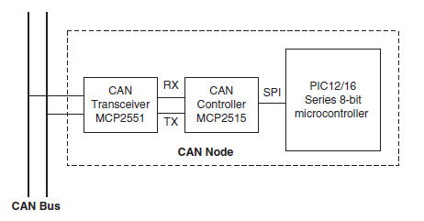
As seen in the block diagram, we can see that the microcontroller is connected to the CAN bus using an external MCP2515 CAN controller chip and an MCP2551 CAN transceiver chip.

Slide 119
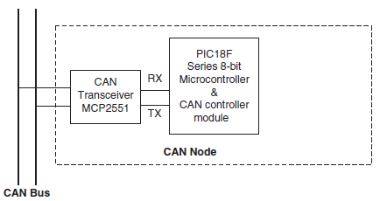
The new CAN bus based designs can use a PIC microcontroller which has built-in CAN controller module.
The figure shown below include built-in CAN controller hardware on the chip.
The microcontroller can be made a CAN node by adding a CAN transceiver chip.

Slide 120
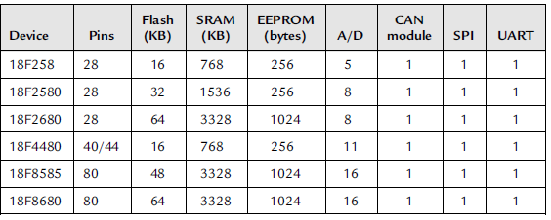
The table shown below indicate some of the PIC microcontrollers that include a CAN module.

Slide 121
PIC18F258 MICROCONTROLLER
PIC18F258 can is one of the PIC microcontroller’s which has got a built-in CAN module.
The features of PIC18F258 microcontroller has the following features.
32K flash program memory
1536 bytes RAM data memory
256 bytes EEPROM memory
22 I/O ports
5-channel 10-bit A/D converters
Three timers/counters
Three external interrupt pins
High-current (25mA) sink/source
Capture/compare/PWM module
SPI/I2C module

Slide 122
CAN 2.0A/B module
Power-on reset and power-on timer
Watchdog timer
Priority level interrupts
DC to 40MHz clock input
8 x8 hardware multiplier
Wide operating voltage (2.0V to 5.5V)
Power-saving sleep mode
The features of the PIC18F258 microcontroller’s CAN module are as follows:
Compatible with CAN 1.2, CAN 2.0A, and CAN 2.0B
Supports standard and extended data frames
Programmable bit rate up to 1Mbit/s
Double-buffered receiver
Three transmit buffers

Slide 123
Two receive buffers
Programmable clock source
Six acceptance filters
Two acceptance filter masks
Loop-back mode for self-testing
Low-power sleep mode
Interrupt capabilities
The CAN module uses port pins RB3/CANRX and RB2/CANTX for CAN bus receive and transmit functions respectively.
These pins are connected to the CAN bus via an MCP2551-type CAN bus transceiver chip.

Slide 124
The PIC18F258 microcontroller supports the following frame types:
Standard data frame
Extended data frame
Remote frame
Error frame
Overload frame
Interframe space
The CAN module in the PIC18F258 microcontroller has six modes of operation:
Configuration mode
Disable mode
Normal operation mode
Listen-only mode
Loop-back mode
Error recognition mode

Slide 125
Configuration Mode:
The CAN module is initialized in configuration mode. During a transmission, the module is not allowed to enter into configuration mode.
In configuration mode, the module will neither transmit nor receive any information. Also the error counters are cleared and the interrupt flags are remain unchanged.
Disable Mode:
In this mode also the module will neither transmit nor receive the data. When the CAN module is in disable mode, the internal clock is stopped till the module becomes active again.
If the module is active then it can enter into the disable mode by accepting 11 recessive bits on CAN bus which detects the condition as an IDLE bus.

Slide 126
The WAKIF interrupt (wake-up interrupt) is the only CAN module interrupt that is active in disable mode.
Normal Operation Mode:
This is the CAN module’s standard operating mode. In this mode, the CAN module monitors all bus messages and generates acknowledge bits, error frames etc.
This is the only mode that can transmit messages.
Listen Only Mode:
The listen-only mode allows the CAN module to receive messages, including messages with errors.
It can be used to monitor bus activities including messages with errors.
It can be used to monitor bus activities or to detect the baud rate on the bus.

Slide 127
For automatic baud-rate detection at-least two other nodes must be communicating with each other.
The baud rate can be determined by testing different values until valid messages are received.
The listen-only mode cannot transmit messages.
Loop-Back Mode:
In the loop-back mode, messages can be directed from internal transmit buffers to receive buffers without actually transmitting messages on the CAN bus.
This mode is useful during system developing and testing.
Error Recognition Mode:
The error recognition mode is used to ignore all errors and receive all messages.
In this mode, all messages, valid or invalid are received and copied to the receive buffer.

Slide 128
CAN Message Transmission:
There are three dedicated transmit buffers that PIC18F258 microcontroller consist of: TXB0, TXB1, TXB2.
The messages that have to transmitted later i.e. pending transmittable messages are stored in a priority queue.
Before the SOF is sent, the priorities of all buffers queued for transmission are compared.
The transmit buffer with the highest priority is sent first.
If two buffers have the same priority then the one with higher buffer number is sent first.
There are four levels of priority.

Slide 129
CAN Message Reception:
Reception of a message is a complex process. The PIC18F258 microcontroller include two receive buffers i.e. RXB0 and RXB1.
Each receive buffer has message acceptance filter.
The messages that are received are stored in a buffer known as Message Assembly Buffer (MAB).
Once a message is received, without consideration the type of the identifier and number of data types, the entire message is copied into MAB.
Received messages have priorities. RXB0 is the higher priority buffer and it has two message acceptance filters RXF0 and RXF1.
RXB1 is the lower priority buffer and has four acceptance filters: RXF2, RXF3, RXF4, and RXF5.

Slide 130
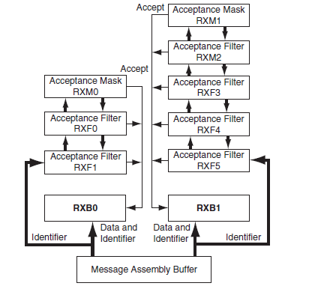
The receive buffer block diagram is shown below with message acceptance filters.

Slide 131
Two programmable acceptance filter masks, RXM0 and RXM1, are also available, one for each receive buffer.
The CAN module uses message acceptance filters and masks to determine if a message in the MAB should be loaded into a receive buffer.
Once a valid message is received by the MAB, the identifier field of the message is compared to the filter values.
If there is a match, that message is loaded into the appropriate receive buffer.
The filter masks determine which bits in the identifier are examined with the filters.
The truth table shown below shows how each bit in the identifier is compared against the masks and filters to determine if the message should be accepted.

Slide 132
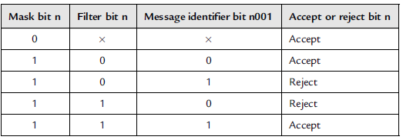
If a mask bit is set to 0, that bit in the identifier is automatically accepted regardless of the filter bit.

Slide 133
MICROC CAN FUNCTIONS
With respect to CAN bus applications there are two libraries that the mikroC language provides.
First library that is provided is the library for PIC microcontrollers with built-in CAN modules.
The other library is based on using a SPI bus for PIC microcontrollers having no built-in CAN modules.
The mikroC CAN functions are supported only by the PIC18XXX8 microcontrollers with MCP2551 or similar CAN transceivers.
Both standard (11 identifier bits) and extended format (29 identifier bits) messages are supported.

Slide 134
The following mikroC functions are provided:
CANSetOperationMode
CANGetOperationMode
CANInitialize
CANSetBaudRAte
CANSetMask
CANSetFilter
CANRead
CANWrite
CANSetOperationMode:
This function can be used to set the CAN operation mode. The function prototype is :
void CANSetOperationMode(char mode, char wait_flag)

Slide 135
The function has got two parameters i.e. mode and wait_flag.
The parameter wait_flag is either 0 or 0xFF. If it is set to 0xFF then function blocks and will not return until the requested mode is set. If it is set to 0, then the function returns as a non-blocking call.
The mode can be any one of the following:
CAN_MODE_NORMAL Normal mode of operation
CAN_MODE_SLEEP Sleep mode of operation
CAN_MODE_LOOP Loop-back mode of operation
CAN_MODE_LISTEN Listen-only mode of operation
CAN_MODE_CONFIG Configuration mode of operation

Slide 136
CANGetOperationMode
The CANGetOperationMode function returns the current CAN operation mode.
The function prototype is:
char CANGetOperationMode(void)
CANInitialize
The CANInitialize function initializes the CAN module.
All mask registers are cleared to 0 to allow all messages.
Upon execution of this function, the normal mode is set.
The function prototype is:
void CANInitialize(char SJW, char BRP, char PHSEG1, char PHSEG2, char PROPEG, char CAN_CONFIG_FLAGS)

Slide 137
where
SJW is the synchronization jump width
BRP is the baud rate prescaler
PHSEG1 is the Phase_Seg1 timing parameter
PHSEG2 is the Phase_Seg2 timing parameter
PROPSEG is the Prop_Seg
CAN_CONFIG_FLAGS can be one of the following configuration flags:
CAN_CONFIG_DEFAULT Default flags
CAN_CONFIG_PHSEG2_PRG_ON Use supplied PHSEG2 value
CAN_CONFIG_PHSEG2_PRG_OFF Use maximum of PHSEG1 or information processing time (IPT) whichever is greater

Slide 138
CAN_CONFIG_LINE_FILTER_ON Use CAN bus line filter for wake-up
CAN_CONFIG_FILTER_OFF Do not use CAN bus line filter
CAN_CONFIG_SAMPLE_ONCE Sample bus once at sample point
CAN_CONFIG_SAMPLE_THRICE Sample bus three times prior to sample point
CAN_CONFIG_STD_MSG Accept only standard identifier messages
CAN_CONFIG_XTD_MSG Accept only extended identifier messages
CAN_CONFIG_DBL_BUFFER_ON Use double buffering to receive data
CAN_CONFIG_DBL_BUFFER_OFF Do not use double buffering

Slide 139
CAN_CONFIG_ALL_MSG Accept all messages including invalid ones
CAN_CONFIG_VALID_XTD_MSG Accept only valid extended identifier messages
CAN_CONFIG_VALID_STD_MSG Accept only valid standard identifier messages
CAN_CONFIG_ALL_VALID_MSG Accept all valid messages
These configuration values can be bitwise AND’ed to form complex configuration values.

Slide 140
CANSetBaudRate
The CANSetBaudRate function is used to set the CAN bus baud rate. The function prototype is:
void CANSetBaudRate(char SJW, char BRP, char PHSEG1, char PHSEG2, char PROPSEG, char CAN_CONFIG_FLAGS)
The arguments of the function are as in function CANInitialize.
CANSetMask
The CANSetMask function sets the mask for filtering messages. The function prototype is:
void CANSetMask(char CAN_MASK, long value, char CAN_CONFIGFLAGS)

Slide 141
CAN_MASK can be one of the following:
CAN_MASK_B1 Receive buffer 1 mask value
CAN_MASK_B2 Receive buffer 2 mask value
Where value is the mask register value.
CAN_CONFIG_FLAGS can be either
CAN_CONFIG_XTD (extended message), or
CAN_CONFIG_STD (standard message).
CANSetFilter:
The CANSetFilter function sets filter values. The function prototype is:
void CANSetFilter(char CAN_FILTER, long value, char CAN_CONFIG_FLAGS)

